Slide 1
Bonbons Sans Frontieres
Eric Grant

Slide 2
Bonbons Sans Frontieres
BSF is a non-profit organization that provides candy to those without access to reliable candy sources.
They are active in covering disasters with massive candy relief packages.
They also take requests from users to determine prime targets for candy aid.

Slide 3
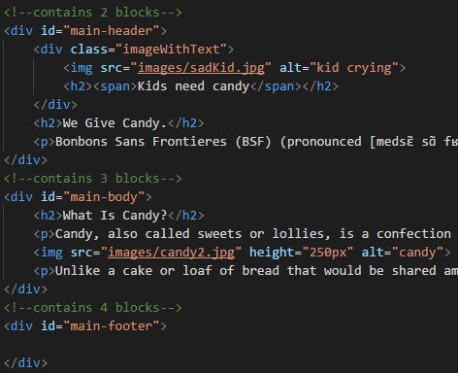
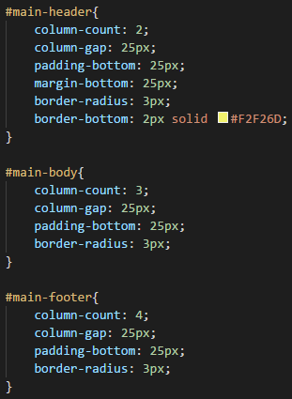
Column Code

Slide 4
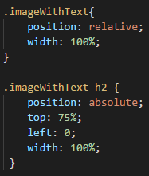

Text Over Image Code

Slide 5
Design
Simplistic fancy style
Nav on top and bottom
Multiple forms
Column based layout
Image links

Slide 6
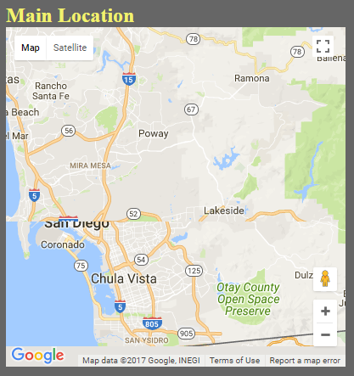

Tech

Slide 7
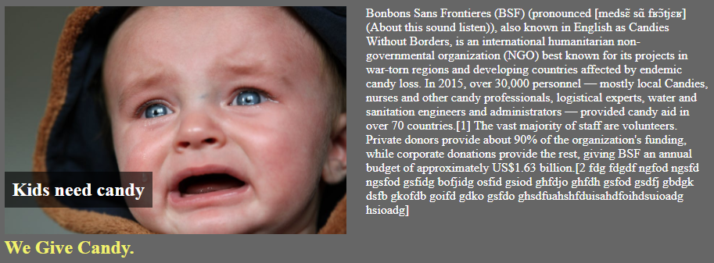
My Big Problem

Slide 8
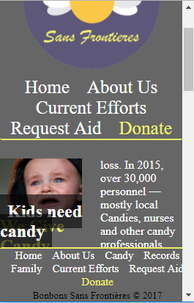
Version 2
Add individual pages for each location.
Fix scaling for mobile devices.

Slide 9
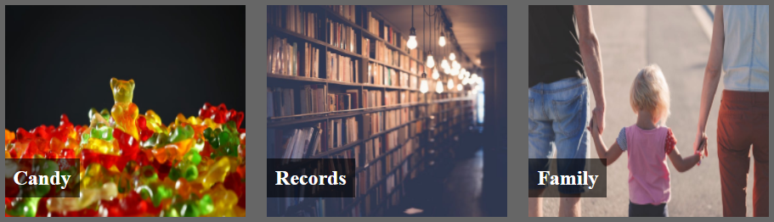
What I learned

Slide 10
Questions?

